Slide 1
Unlink
Capstone Project - Battle Bugs

Slide 2
Project Description
Unlink is a tool allowing users to input their personal information(PI) to find a list of websites that contain that information in order to assist the user in having their PI removed.

Slide 3
System Overview
Desktop application
Built on Windows (but can run on any OS)
Built with Java
Portable with JVM
Eclipse IDE
Maven
Current size: 1.07 MB
System Architecture (Layers)
SerpAPI

Slide 4
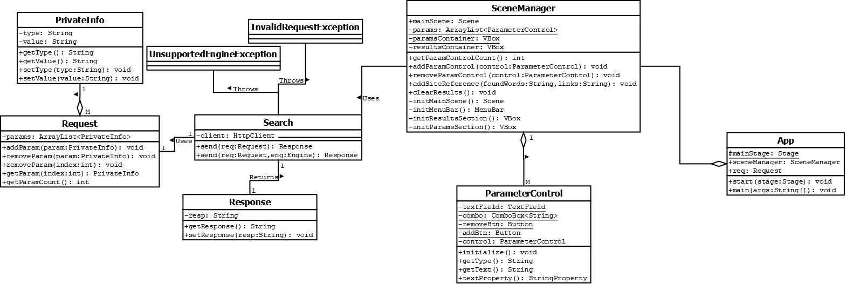

Slide 5
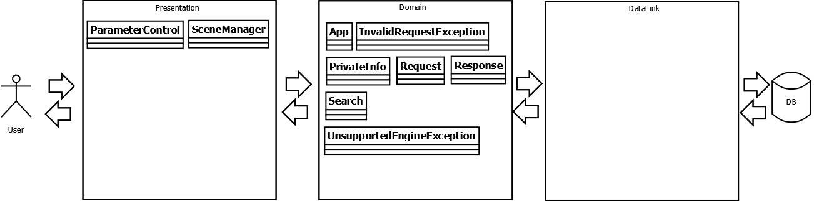
System Architecture (Layers)

Slide 6
Current Functionality
GUI
PI can be added or removed.
SerpAPI integrated and fully functional.
Concatenates all PI in the search into a single query
Debug mode which avoids using real (limited) searches with SerpAPI and instead provides a copy of a pre-made search.

Slide 7
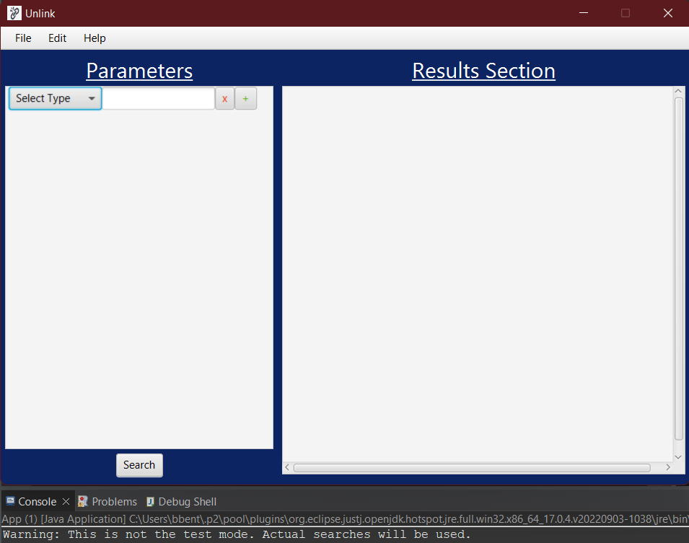

Slide 8
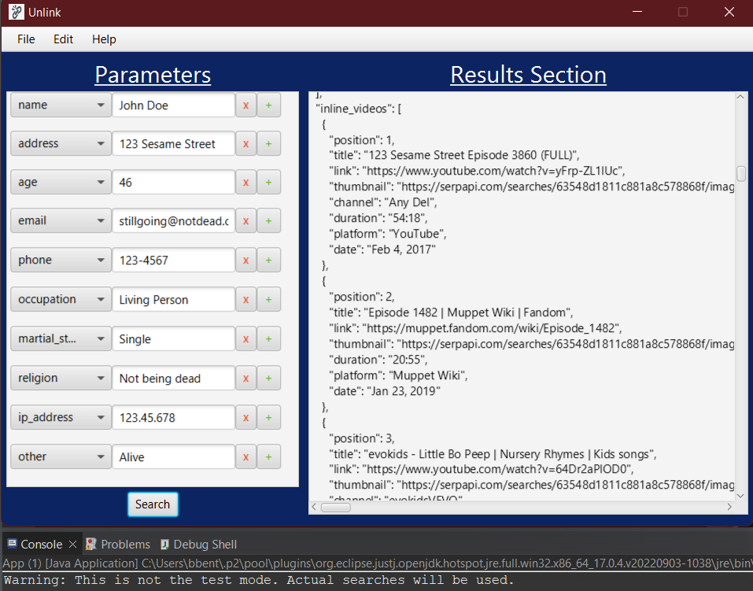

Slide 9
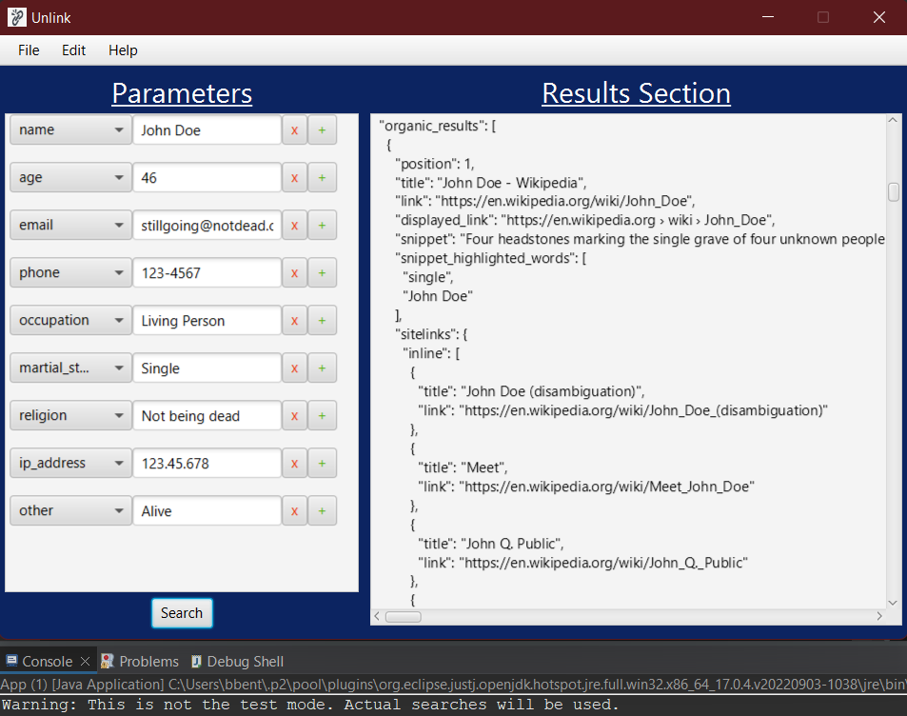

Slide 10
Criticism
In order to use our program an individual’s SerpAPI key must be implemented. As of right now it must be directly changed through our code.

Slide 11
Viability of Current Solution
As of right now where we stand in the project our current architecture will be good enough for the remainder of the project. This means no modifications are necessary in the near future. The only modifications we can see is if we’re far ahead of schedule and additional functionality is introduced.

Slide 12
Testing Strategy
The testing strategy that has been implemented within the development mostly takes the form of a behavioral type. With this type of strategy, the focus is more geared towards the way our program acts and emphasizes all of the different elements that go into the user’s journey when using the program.
Because of this, the testing of the program has been molded around the usage of test case scenarios, which depicts the series of actions a user will take when using the program, mostly derived from the details that make up our Use Cases.

Slide 13
Questions?

